Slide 1
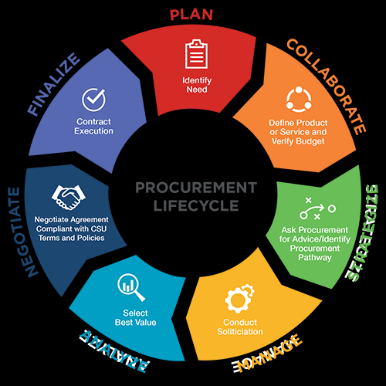
What factors should be considered during the purchasing process?
Customer preferences
The food and nutrition services budget
Nutritional content and the menu
All of the above

Slide 2
What factors should be considered during the purchasing process?
Customer preferences
The food and nutrition services budget
Nutritional content and the menu
All of the above

Slide 3
What information is contained in a good product specification or description?
Menu
Cost of the product
Package unit
Shipping location

Slide 4
What information is contained in a good product specification or description?
Menu
Cost of the product
Package unit
Shipping location

Slide 5
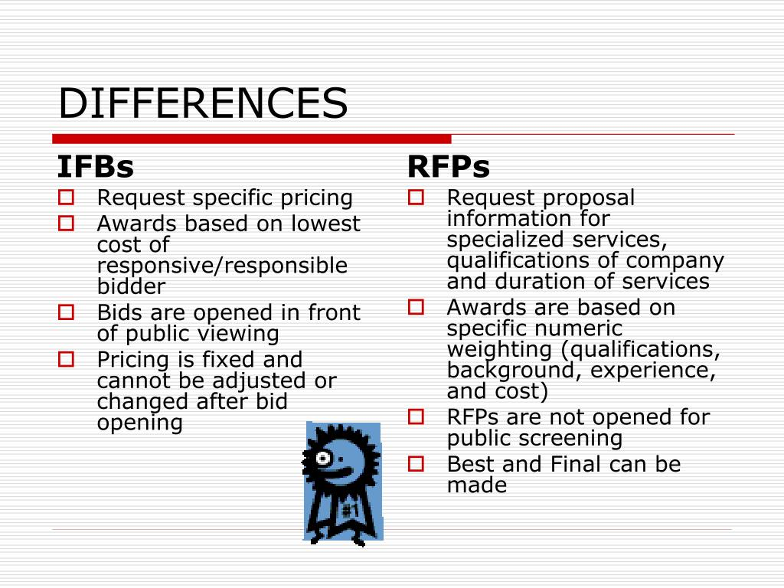
The invitation for bid and a request for proposal are the same thing.
True
False

Slide 6
The invitation for bid and a request for proposal are the same thing.
True
False

Slide 7
Websites with Procurement Q & A and Information
https://www.cde.ca.gov/ls/nu/pr/procurementcnpfaqs.asp
https://schoolnutrition.org/uploadedFiles/Resources_and_Research/Operations/WhitePaper-SolvingtheProcurementPuzzle.pdf
https://doe.sd.gov/cans/documents/ICN-procurement.pdf Procurement in the 21st Century Manual
https://www.esc4.net/Assets/procument-6-hr-2019.pdf Procurement in the 21st Century Power Point

Slide 8
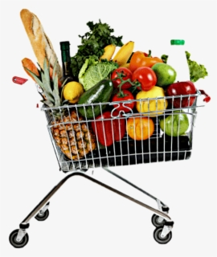
Who may be responsible for procurement in school food and nutrition services program?
The school district
The state agency
A cooperative buying group
Any of the above

Slide 9
Who may be responsible for procurement in school food and nutrition services program?
The school district
The state agency
A cooperative buying group
Any of the above

Slide 10
What information is contained within a bid document?
Current product prices
Product specifications or descriptions
A fax number for returning bid information
Names of personnel

Slide 11
What information is contained within a bid document?
Current product prices
Product specifications or descriptions
A fax number for returning bid information
Names of personnel

Slide 12
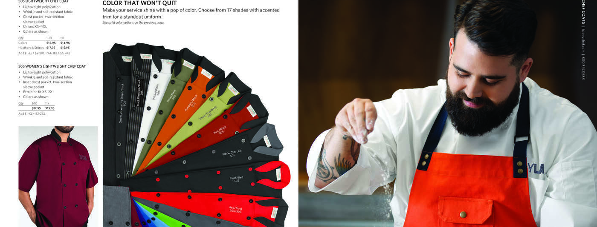
Value-added service
Total cost
Ability to service the account
Uniforms provided
What criterion is not used to evaluate a bid response?

Slide 13
Value-added service
Total cost
Ability to service the account
Uniforms provided
What criterion is not used to evaluate a bid response?

Slide 14
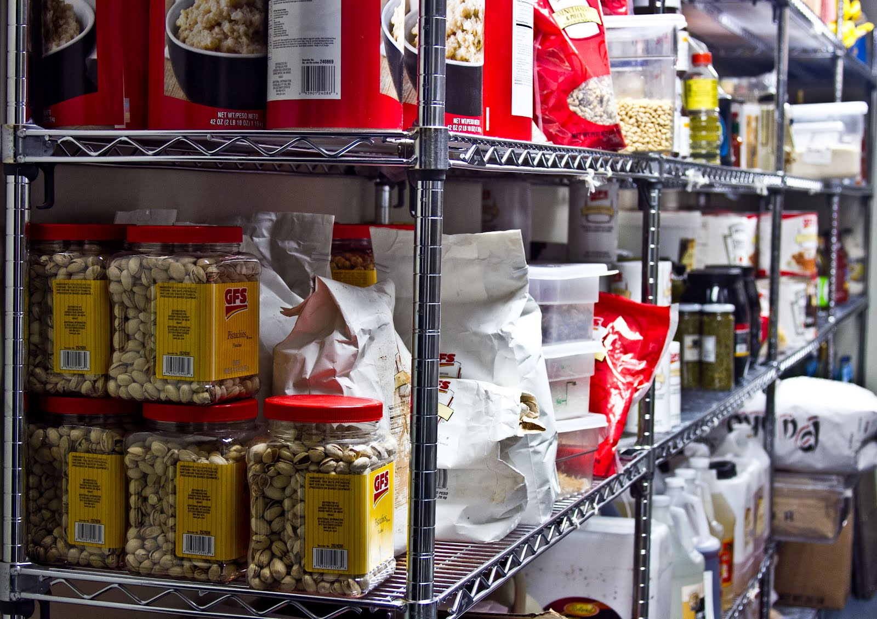
What processes are used to manage food and supplies?
Effective receiving
Proper storage
Inventory management
All of the above

Slide 15
What processes are used to manage food and supplies?
Effective receiving
Proper storage
Inventory management
All of the above

