Slide 1
Prioritize for Work-Life Balance
Laurel Brown
Assistant Director, University of Florida Community Engagement

Slide 2
Prioritize for Work-Life Balance

Slide 3
How do you define work-life balance; what comes to mind when you think of this term?

Slide 4
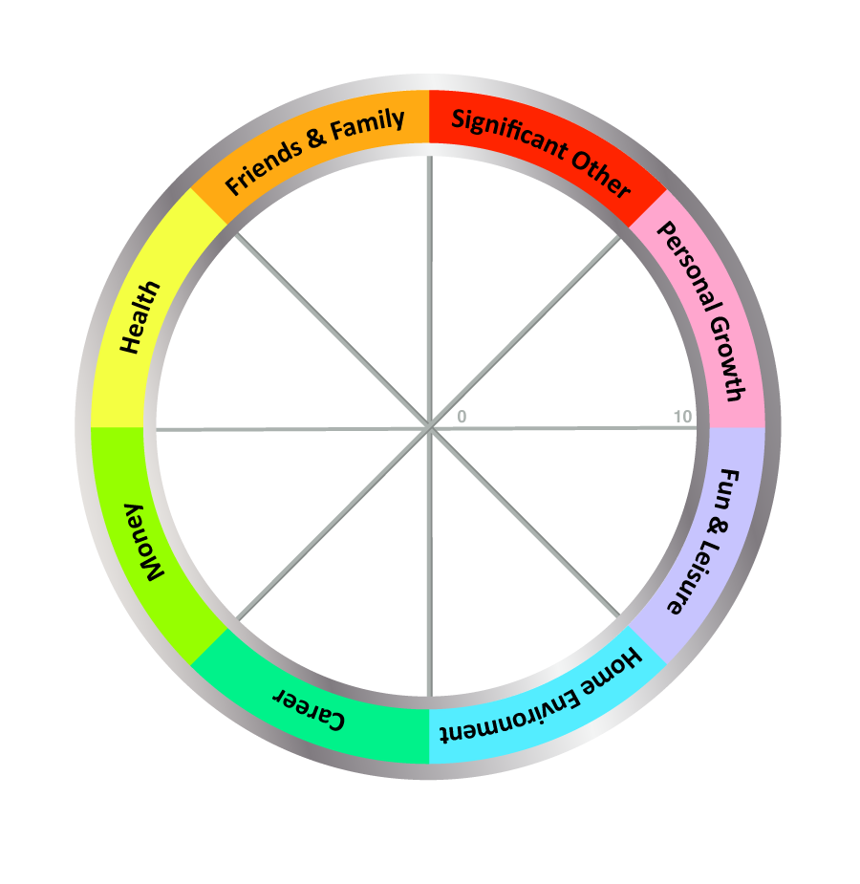
WHEEL OF LIFE – EXERCISE
EXAMPLE
2
5
9
8
8
4
6
7

Slide 5
WORK LIFE BALANCE OR INTEGRATION?
It's been about 40 years since the term work-life balance was first used
The term creates an artificial separation between work and life

Slide 6
WORK LIFE INTEGRATION
An approach that creates more synergies between all areas that define life…
work, home/family, community, personal well-being, and health
Work-life balance is a separation of your professional and personal lives, work-life integration is a connection between work and life

Slide 7
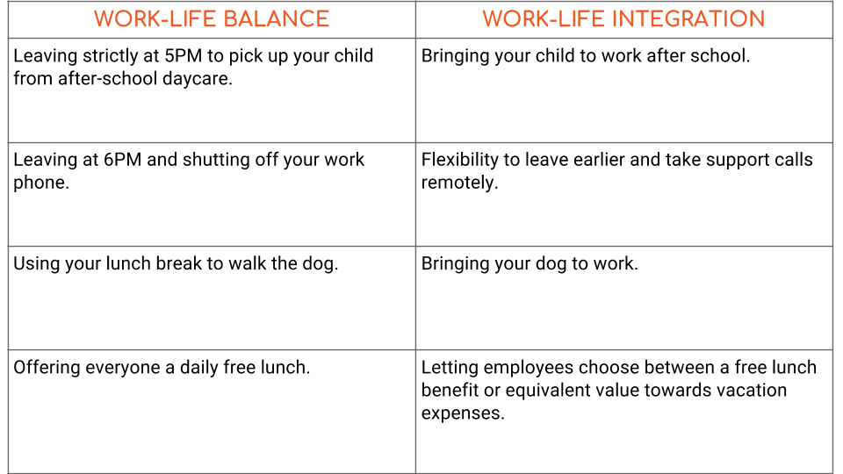
WORK LIFE INTEGRATION

Slide 8
WORK LIFE INTEGRATION
Not perfect solution, easy to ‘integrate’ work into every area of life
Work responsibilities tend to feel far more urgent than the everyday needs
"Some of us get so used to the adrenaline rush of handling crises that we become dependent on it for a sense of excitement and energy.“ ~Stephen Covey

Slide 9
HEALTHY RELATIONSHIP WITH WORK
Set Limits
Manage your time
Learn to say "no"
Consider your options
When you quit accepting tasks out of guilt or a false sense of obligation, you'll have more time for activities that are meaningful to you.

Slide 10
HEALTHY RELATIONSHIP WITH WORK
Self-Care
Relax
Volunteer
Develop a support system

Slide 11
THE CONSEQUENCES
Fatigue
3 in 10 workers have had an accident, made a serious mistake or felt exceptionally stressed as a result of tiredness
23% of construction industry employees and 28% of manufacturing workers admitted falling asleep at work

Slide 12
THE CONSEQUENCES
Poor health
Damaged relationships
Creating work-life balance is a continuous process
Periodically examine your priorities and make changes, as needed

Slide 13
PRIORITIES, PRODUCTIVITY & BALANCE
No one can work at optimal efficiency all the time.
The main tenet of more productive work is to work smarter rather than harder
Create a prioritization strategy and worker smarter not harder

Slide 14
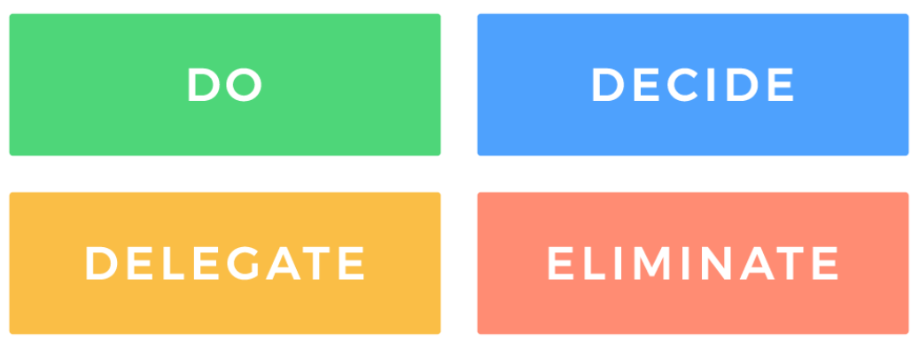
PRIORITIZATION STRATEGY
Eisenhower Matrix. Sort tasks by urgency and importance.

Slide 15
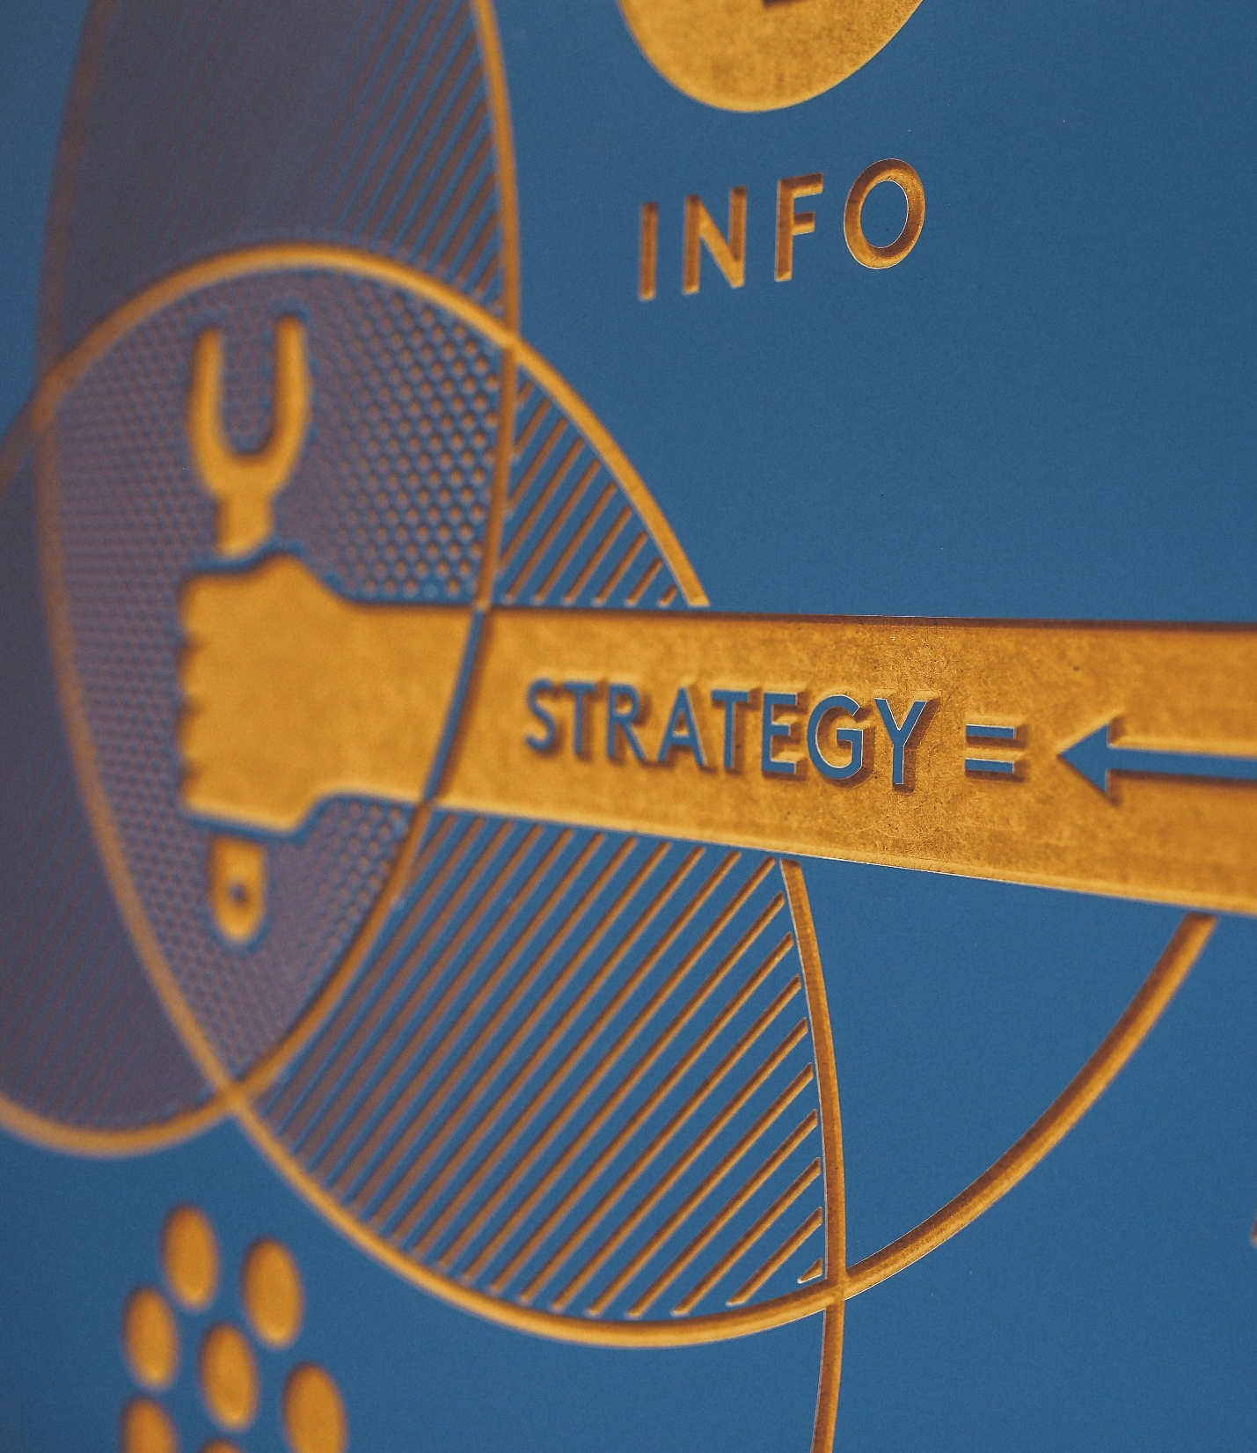
PRIORITIZATION STRATEGY
The Pareto Principle, or 80-20 Rule.
Identify 20 percent of tasks as the most important; spend the most time on them
Minimize the amount of time spent on the remaining 80 percent

Slide 16
ASK QUESTIONS
Does this task directly support the goals I set for this time period?
What do I absolutely have to accomplish today?
When does this need to get done by?
Am I excited about this?
Is my team excited about this?
Do I have the energy and brainpower required to do this effectively today/right now?

Slide 17
PROCRASTINATION
Discuss with one another: Do you procrastinate? If so, what are your excuses? How have you overcome procrastination?
Waiting for the right time/inspiration
Need to clear my desk first
Check in with colleagues about lunch plans
Fall into your inbox with no real end in sight
Remember: simply staying busy does not equate to being productive

Slide 18
PRODUCTIVITY HACKS
Save
Save distractions for later
Subdivide
Subdivide your tasks
Leverage
Leverage shortcuts
Match
Match the task to your energy
Find
Find the best tactics that work for you.

Slide 19
MAKING IT WORK
Pause and Reflect
What is currently causing me stress, unbalance, or dissatisfaction?
How are these circumstances affecting how I perform and engage with my job?
How are they impacting my personal life?
What am I prioritizing?
What am I sacrificing?
What is getting lost?

Slide 20
MAKING IT WORK
Pay attention to your emotions
Consider alternatives
Implement changes

Slide 21
REDUCE STRESS, INCREASE RESILIENCE
Resilience is not the absence of distress or difficulty. Resilience is the ability to adapt and grow following adversity.

Slide 22
BUILD RESILIENCE
Make connections, build your social support network
Don’t view crises as insurmountable challenges
Accept that change is natural and unavoidable
Look for opportunities for self-discovery

Slide 23
BUILD RESILIENCE
Nurture a positive view of yourself and your abilities
Keep things in perspective and in context
Maintain a hopeful outlook on life
Take care of yourself

Slide 24
LOOK TO NATURE FOR RELIEF
Research reveals: our environments can increase or reduce our stress, which impacts our bodies.
What you see, hear, or experience changes not only your mood, but how your nervous, endocrine, and immune systems work.

Slide 30
SUMMARY
Work-life integration will be an ongoing challenge
Set limits and look after yourself
Creating a balance between work and life is a continuous process as your family, interests and work change
Periodically examine your priorities — and make changes, if necessary
REMEMBER: to pause, connect with your emotions, rethink your priorities, evaluate alternatives, and implement changes — forever!

