Slide 1

Florida
KIDS COUNT!
Norín Dollard, Ph.D.
Department of Child & Family Studies
Louis de la Parte Florida Mental Health Institute
College of Behavioral & Community Sciences
Florida School Nutrition Association
Tallahassee, Florida February 24, 2020

Slide 2
Agenda
Annie E. Casey & KIDS COUNT
  Overview – national perspective
  2019 Databook findings
  Florida Child Well-being Index
  KIDS COUNT products and how you can use them

Slide 3
Annie E. Casey Foundation
Founded in 1949, the Annie E. Casey Foundation was created to help America’s kids have a brighter future by
  strengthening families,
  building stronger communities, and,
  ensuring access to opportunity.

Slide 4
Building a brighter future…
One way Casey achieves this is by providing reliable data analysis through the KIDS COUNT grants in all 50 states, Washington, D.C., Puerto Rico and the Virgin Islands
Casey funds these groups to collect data and report on the most critical measures of child and family well-being in their states.
http://datacenter.kidscount.org/

Slide 5
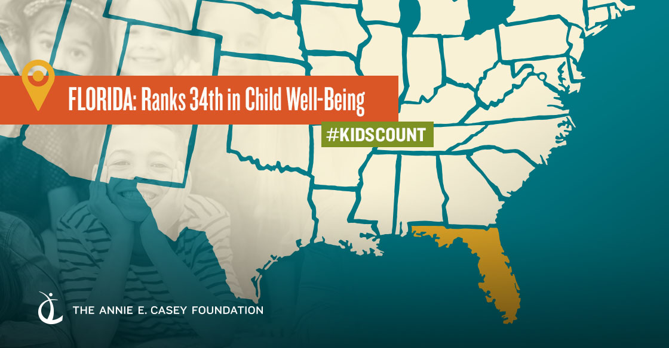
About KIDS COUNT
37
2019
Notes:
The KIDS COUNT Data Book provides state-by-state data for 16 indicators of child well-being.
These indicators are organized into four domains: economic well-being, health, education and family and community. This data is used to create a composite score that allows us to rank states overall, by domain, and by individual indicators.
Every year we look at the direction in which each state is going. Each Data Book is a call to action of some kind

Slide 6
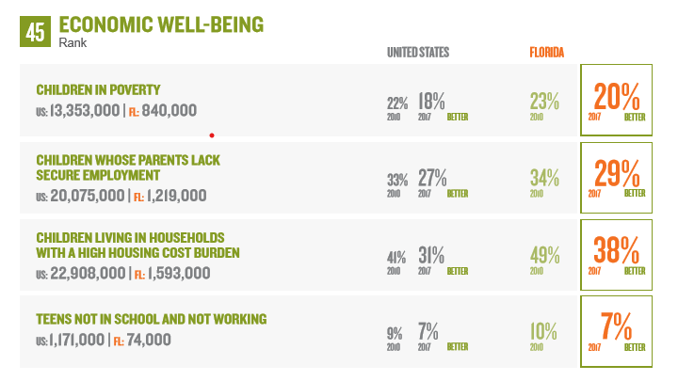
About KIDS COUNT
2019
Notes:
The KIDS COUNT Data Book provides state-by-state data for 16 indicators of child well-being.
These indicators are organized into four domains: economic well-being, health, education and family and community. This data is used to create a composite score that allows us to rank states overall, by domain, and by individual indicators.
Every year we look at the direction in which each state is going. Each Data Book is a call to action of some kind

Slide 7
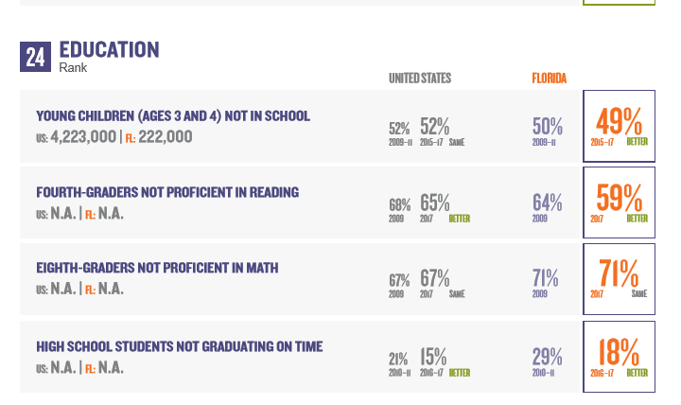
2019

Slide 8
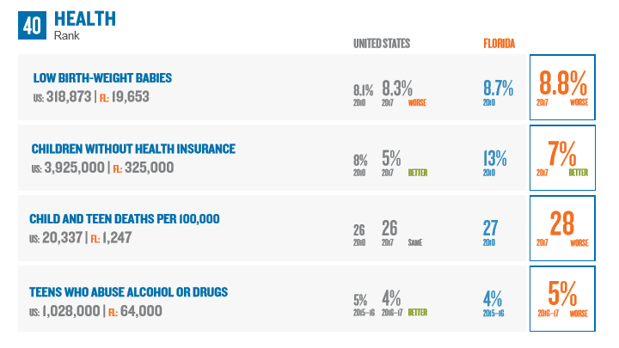
2019

Slide 9
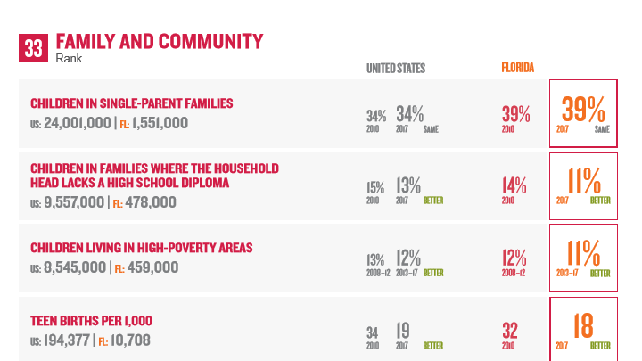

Slide 10
Population 2017
Total Population 20,484,142 - Child Population: 4,180,677

Slide 11
Population in poverty – 2013-2017
Notes:
The poverty threshold for a family of 4 – two adults and two children under 18 – in 2016 was $24,339.

Slide 12
Population <18 living in concentrated areas of poverty 2013-2017
Notes:
Children living in census tracts with poverty rates of 30 percent or more by race and ethnicity.
Research indicates that as neighborhood poverty rates increase, undesirable outcomes rise and opportunities for success are less likely. The effects of concentrated poverty begin to appear once neighborhood poverty rates rise above 20 percent and continue to grow as the concentration of poverty increases up to the 40 percent threshold. This indicator defines areas of concentrated poverty as those census tracts with overall poverty rates of 30 percent or more because it is a commonly used threshold that lies between the starting point and leveling off point for negative neighborhood effects. The 2016 federal poverty threshold is $$24,339 per year for a family of two adults and two children.

Slide 13
What does it take to live?
Housing cost burden (2017)
  38% of Florida households had housing costs that exceeded 30% of their average annual income
At minimum wage, an affordable apartment is $440. The fair market rent for a 1 bedroom apartment is $957. At minimum wage ($8.46) you would have to work 87 hours per week to afford this (2019).
Notes:
Source: American Community Survey 5 year estimates table B25106
Occupied households – both renter and owner occupied
Source: National Low Income Housing Coalition, Out of Reach Report http://nlihc.org/oor/florida

Slide 14
ALICE (Asset-limited, income constrained, and employed)
46% (N = 3,480,886) of Florida households live below the ALICE threshold
Median household income is $55,433 (2018)
United Way (2019). Available at http://https://www.uwof.org/alice
Notes:
14.0% are below federal poverty level
Median household data from SAIPE

Slide 15
ALICE – Asset limited, income constrained (2016)
 | Single Adult | 2 Adults, 1 Infant & 1 Preschooler
Housing | $617 | $848
Child Care | N/A | $1,024
Food | $164 | $542
Transportation | $326 | $653
Health Care | $195 | $720
Technology | $55 | $75
Miscellaneous | $157 | $418
Taxes | $212 | $317
Monthly Total | $1,726 | $4,597
Annual Total | $20,712 | $55,164
Hourly wage to support this budget | $10.36 | $27.58

Slide 16
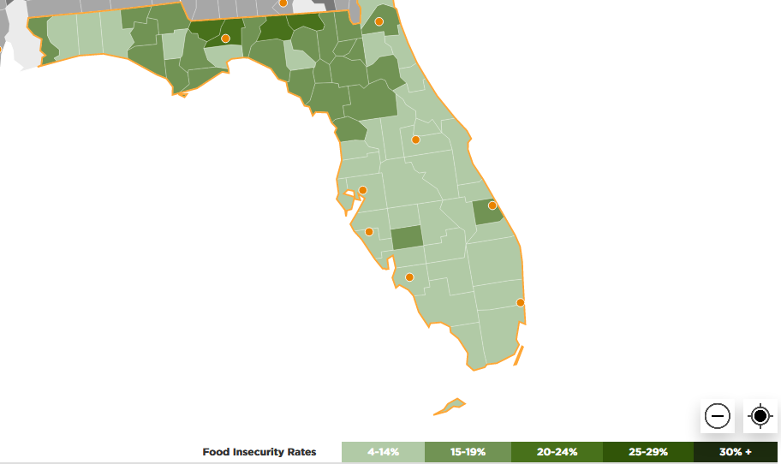
Food insecurity rate in 2017 for all people in Florida was 13.7%
Child food insecurity rate was 20.4% (854,880)
https://map.feedingamerica.org/county/2017/overall/florida
Notes:
The map shown was for the total population so I clarified that in the title.

Slide 17
What do we know
We are making progress, but there is much to be done.
Poverty
  Florida’s families need skills and education to better support their children
  We’ve made great strides in getting children health insurance – we can’t afford to lose ground
  Florida’s families need affordable housing
Notes:
Skills and education for parents - (indicators: 7,857 [9.4%] of families have a head of household with less than a high school diploma and 3,988 [6.6%] of own children [living in families and subfamilies] are living with no parent(s) who are in the labor force)
Health insurance

Slide 18
What do we do?
In terms of child well-being, Florida has a lot of work to do
  Poverty – despite an improving economy, a fifth of our children or more live in poverty
  We need to do more to ensure those who are eligible get the assistance they qualify for
  Where you live matters
    A growing number of children are living in areas of concentrated poverty
    Their neighborhoods are frequently those without access to quality food
    Their neighborhoods are also likely those with under-resourced schools

Slide 19
Takeaways
Continue (and expand) child abuse prevention
Continue diversion and civil citation programs
Continue and expand poverty amelioration efforts, including nutrition

Slide 20
What does Florida KIDS COUNT offer?
Policy oriented data products
Visit Floridakidscount.org
Topics include state and county child and family characteristics as well as special topical publications on insurance, parental incarceration, and more

Slide 21
2019 Florida Child Well-Being Index
Get your county’s at floridakidscount.org
NOW
AVAILABLE!!

Slide 22
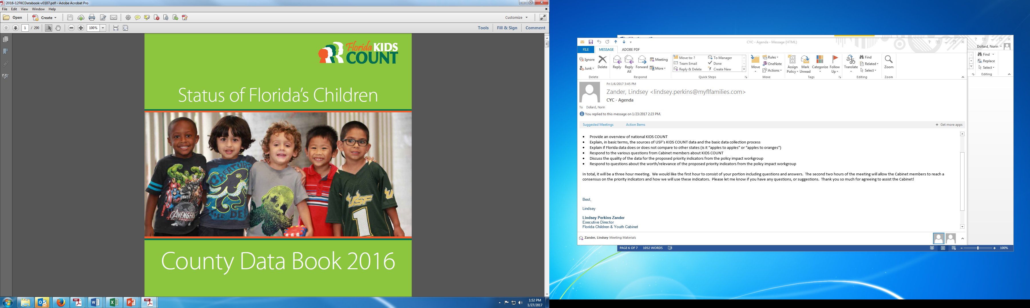

Slide 23
2016 Florida Data Book
Provides state and county level profiles including data on population demographics, economic well-being, educational attainment, health indicators and risk factors.
Uses publicly available data from national sources including the U.S. Census as well as state and county level data from sources such as the Department of Juvenile Justice, the Office of Economic and Demographic Research and the Florida Department of Health.

Slide 25
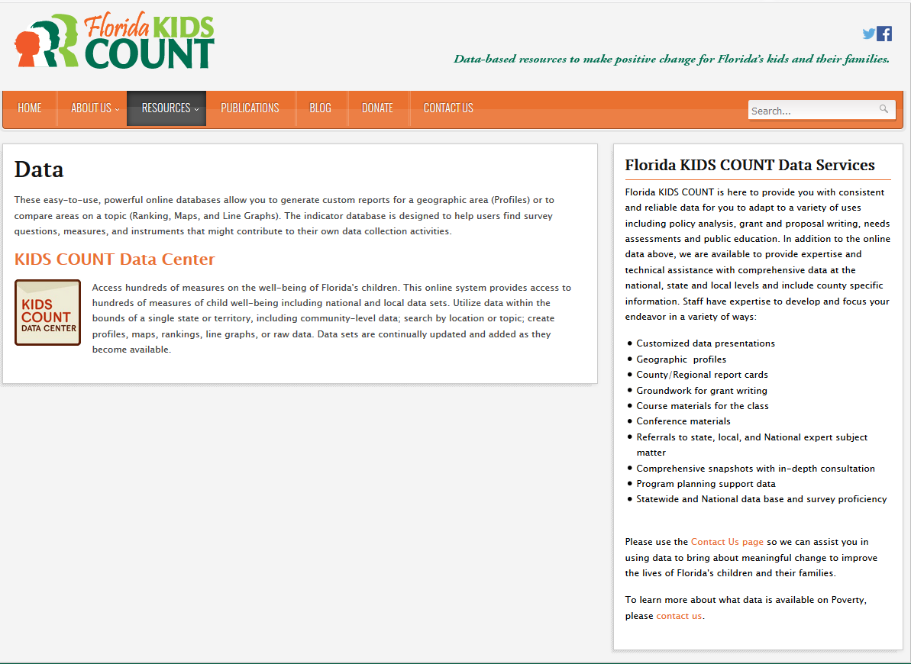
Get, graph and share the data at the AECF KIDS COUNT Data Center

Slide 26


Slide 27
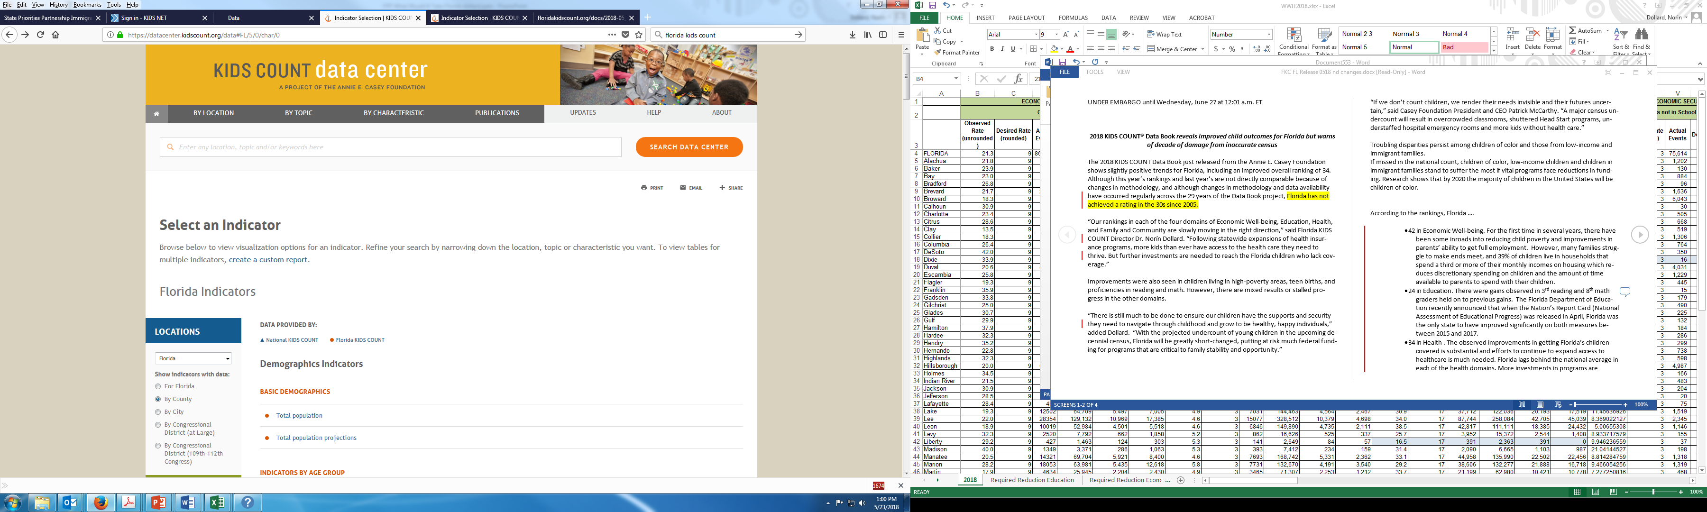
Pick an indicator and geography

Slide 28
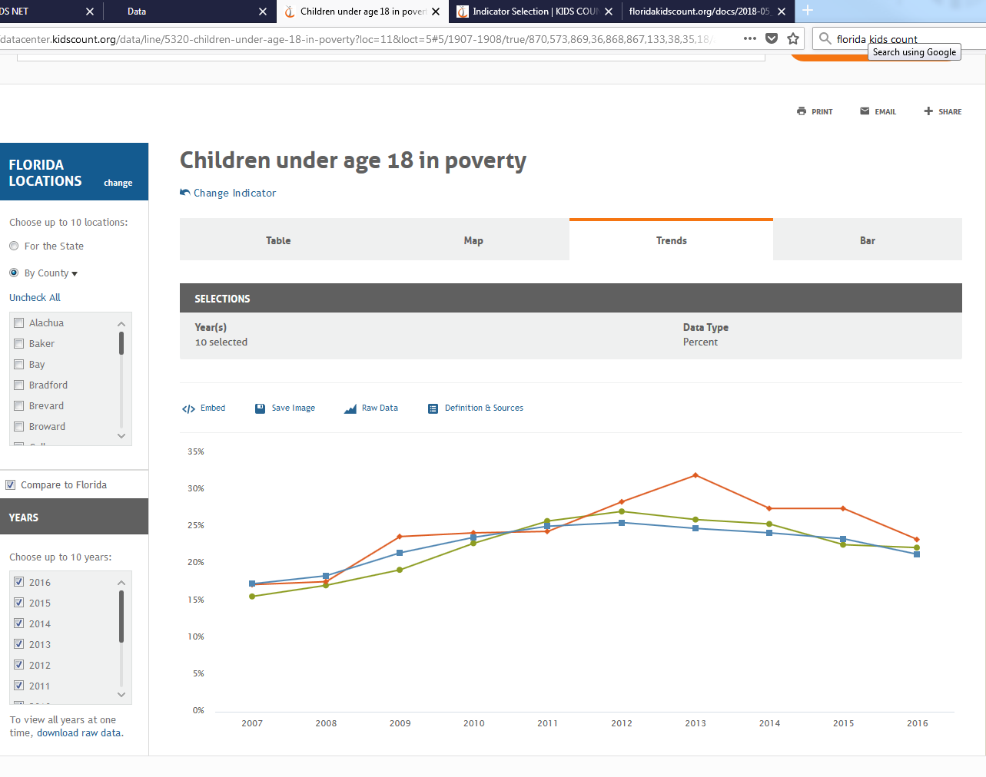
Graph it….
Print or share
Graph it

Slide 29
What else?
You can ask KIDS COUNT things like
Can you get me those data for my county?
Can you update that with the latest data?
What else is out there that describes poverty in my community? (e.g., the United Way’s ALICE report at http://www.uwof.org/alice)

Slide 30
How can you use KIDS COUNT resources?
Check out the Data Center and see what data are there already that meet your needs
Look at www.flkidscount.org and look at our state and national KIDS COUNT and Casey publications to see what has been done and might be replicated for your community

Slide 31
How can you use KIDS COUNT resources?
Don’t see what you are looking for?
  Call or email us, we can help you find data related to your interest area
Help you evaluate the quality of data source(s) and how to present them
Help you develop a ‘data brief’ on your topic

Slide 32
Thank you
Questions?
Norín Dollard, Ph.D.
dollard@usf.edu
(813) 974-3761
Visit our website http://floridakidscount.org/
Like us on Facebook & follow us on Twitter @FLKidsCount

